Slide 1
Introduction to Recurrent Neural Networks

Slide 2
Application of RNN
Sequence Modelling
Text Classification
Machine Translation
Stock market prediction
Speech Recognition
Image captioning

Slide 3
Before RNN Bag of words
https://github.com/rasbt/python-machine-learning-book-3rd-edition/blob/master/ch08/ch08.ipynb

Slide 4
Before RNN Bag of words
https://github.com/rasbt/python-machine-learning-book-3rd-edition/blob/master/ch08/ch08.ipynb

Slide 5
Before RNN Bag of words
https://github.com/rasbt/python-machine-learning-book-3rd-edition/blob/master/ch08/ch08.ipynb

Slide 6
Before RNN Bag of words

Slide 7
Feature Extraction from words
Word count
One hot Encoding
TF-IDF
Embeddings(word2vec, glove etc)

Slide 8
One Hot Encoding

Slide 9
TF_IDF
TF = (Number of repetitions of word in a document) / (# of words in a document)
IDF =Log[(# Number of documents) / (Number of documents containing the word)]
Tf-idf=TF*IDF

Slide 10
TF-IDF
Token | Sen-1 | Sen-2 | Sen-3 | TF(Sen-1) | TF(Sen-2) | TF(Sen-3)
and | 0 | 0 | 2 | 0 | 0 | 0.14285714
is | 1 | 1 | 3 | 0.25 | 0.25 | 0.21428571
one | 0 | 0 | 2 | 0 | 0 | 0.14285714
shining | 1 | 0 | 1 | 0.25 | 0 | 0.07142857
sun | 1 | 0 | 1 | 0.25 | 0 | 0.07142857
sweet | 0 | 1 | 1 | 0 | 0.25 | 0.07142857
the | 1 | 1 | 2 | 0.25 | 0.25 | 0.14285714
two | 0 | 0 | 1 | 0 | 0 | 0.07142857
weather | 0 | 1 | 1 | 0 | 0.25 | 0.07142857
Token | Sen-1 | Sen-2 | Sen-3 | Word Freq in Doc | IDF
and | 0 | 0 | 2 | 2 | 0.17609126
is | 1 | 1 | 3 | 5 | -0.2218487
one | 0 | 0 | 2 | 2 | 0.17609126
shining | 1 | 0 | 1 | 2 | 0.17609126
sun | 1 | 0 | 1 | 2 | 0.17609126
sweet | 0 | 1 | 1 | 2 | 0.17609126
the | 1 | 1 | 2 | 4 | -0.1249387
two | 0 | 0 | 1 | 1 | 0.47712125
weather | 0 | 1 | 1 | 2 | 0.17609126

Slide 11
TF-IDF
Token | Sen-1 | Sen-2 | Sen-3 | TF(Sen-1) | TF(Sen-2) | TF(Sen-3) | IDF | TF-IDF(Sen-1) | TF-IDF(Sen-2) | TF-IDF(Sen-3)
and | 0 | 0 | 2 | 0 | 0 | 0.14285714 | 0.176091259 | 0 | 0 | 0.025155894
is | 1 | 1 | 3 | 0.25 | 0.25 | 0.21428571 | -0.22184875 | -0.055462187 | -0.055462187 | -0.047539018
one | 0 | 0 | 2 | 0 | 0 | 0.14285714 | 0.176091259 | 0 | 0 | 0.025155894
shining | 1 | 0 | 1 | 0.25 | 0 | 0.07142857 | 0.176091259 | 0.044022815 | 0 | 0.012577947
sun | 1 | 0 | 1 | 0.25 | 0 | 0.07142857 | 0.176091259 | 0.044022815 | 0 | 0.012577947
sweet | 0 | 1 | 1 | 0 | 0.25 | 0.07142857 | 0.176091259 | 0 | 0.044022815 | 0.012577947
the | 1 | 1 | 2 | 0.25 | 0.25 | 0.14285714 | -0.124938737 | -0.031234684 | -0.031234684 | -0.017848391
two | 0 | 0 | 1 | 0 | 0 | 0.07142857 | 0.477121255 | 0 | 0 | 0.03408009
weather | 0 | 1 | 1 | 0 | 0.25 | 0.07142857 | 0.176091259 | 0 | 0.044022815 | 0.012577947

Slide 12
Introduction
https://sebastianraschka.com/pdf/lecture-notes/stat479ss19/L14_intro-rnn-part2_slides.pdf

Slide 13

Types of RNN
http://karpathy.github.io/2015/05/21/rnn-effectiveness/

Slide 14
Weight Matrix
https://sebastianraschka.com/pdf/lecture-notes/stat479ss19/L14_intro-rnn-part2_slides.pdf

Slide 15
Weight Matrix
https://sebastianraschka.com/pdf/lecture-notes/stat479ss19/L14_intro-rnn-part2_slides.pdf

Slide 16
Weight Matrix
https://sebastianraschka.com/pdf/lecture-notes/stat479ss19/L14_intro-rnn-part2_slides.pdf

Slide 17
Backpropagation through time (BPTT)
T

Slide 18
Backpropagation through time (BPTT)
https://sebastianraschka.com/pdf/lecture-notes/stat479ss19/L14_intro-rnn-part2_slides.pdf

Slide 19
Backpropagation through time (BPTT)
https://sebastianraschka.com/pdf/lecture-notes/stat479ss19/L14_intro-rnn-part2_slides.pdf

Slide 20
Solutions to the vanishing/exploding gradient problems
Gradient Clipping
Truncated backpropagation through time (TBPTT)
Long short-term memory (LSTM)

Slide 21

RNN

Slide 22


Long short-term memory (LSTM)
https://colah.github.io/posts/2015-08-Understanding-LSTMs/

Slide 23

Long short-term memory (LSTM)
https://colah.github.io/posts/2015-08-Understanding-LSTMs/

Slide 24

Long short-term memory (LSTM)
https://colah.github.io/posts/2015-08-Understanding-LSTMs/

Slide 25

Long short-term memory (LSTM)
https://colah.github.io/posts/2015-08-Understanding-LSTMs/

Slide 26

Long short-term memory (LSTM)
https://colah.github.io/posts/2015-08-Understanding-LSTMs/

Slide 27

Long short-term memory (LSTM)
https://colah.github.io/posts/2015-08-Understanding-LSTMs/

Slide 28
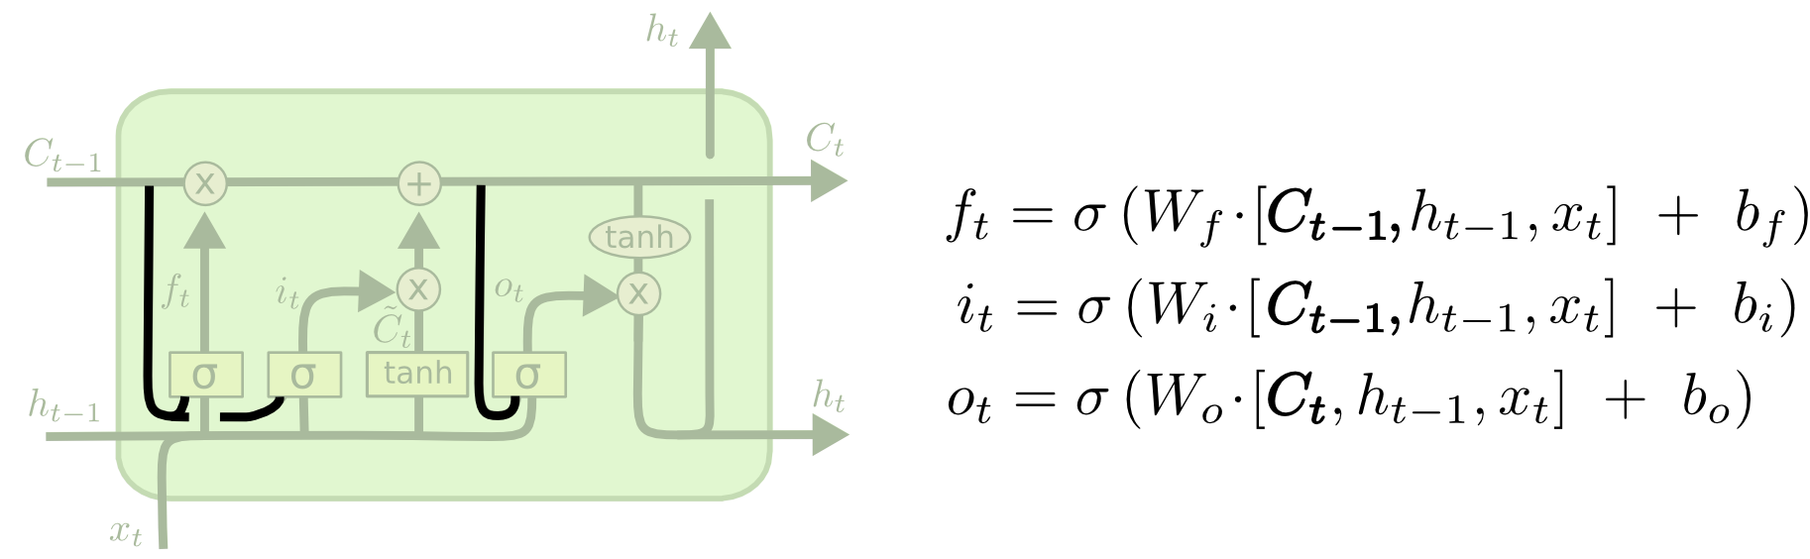
Peephole Long short-term memory (LSTM)
https://colah.github.io/posts/2015-08-Understanding-LSTMs/

Slide 29
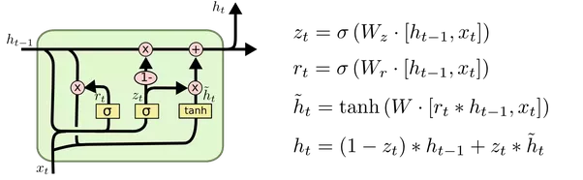
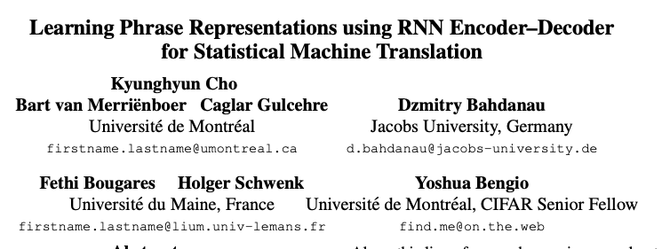
Gated Recurrent Unit(GRU)

